Slide 1
Loop Transformations and Locality

Slide 2
Agenda
Introduction
Loop Transformations
Affine Transform Theory

Slide 3
Memory Hierarchy
CPU
C
C
Cache
Memory

Slide 4
Cache Locality
Suppose array A has column-major layout
A[1,1] | A[2,1] | … | A[1,2] | A[2,2] | … | A[1,3] | …
for i = 1, 100
for j = 1, 200
A[i, j] = A[i, j] + 3
end_for
end_for
Loop nest has poor spatial cache locality.

Slide 5
Loop Interchange
Suppose array A has column-major layout
A[1,1] | A[2,1] | … | A[1,2] | A[2,2] | … | A[1,3] | …
for i = 1, 100
for j = 1, 200
A[i, j] = A[i, j] + 3
end_for
end_for
for j = 1, 200
for i = 1, 100
A[i, j] = A[i, j] + 3
end_for
end_for
New loop nest has better spatial cache locality.

Slide 6
Interchange Loops?
for i = 2, 100
for j = 1, 200
A[i, j] = A[i-1, j+1]+3
end_for
end_for
j
i
e.g. dependence from (3,3) to (4,2)

Slide 7
Dependence Vectors
Distance vector (1,-1) = (4,2)-(3,3)
Direction vector (+, -) from the signs of distance vector
Loop interchange is not legal if there exists dependence (+, -)
j
i

Slide 8
Agenda
Introduction
Loop Transformations
Affine Transform Theory

Slide 9
Loop Fusion
for i = 1, 1000
A[i] = B[i] + 3
end_for
for j = 1, 1000
C[j] = A[j] + 5
end_for
for i = 1, 1000
A[i] = B[i] + 3
C[i] = A[i] + 5
end_for
Better reuse between A[i] and A[i]

Slide 10
Loop Distribution
for i = 1, 1000
A[i] = A[i-1] + 3
end_for
for i = 1, 1000
C[i] = B[i] + 5
end_for
for i = 1, 1000
A[i] = A[i-1] + 3
C[i] = B[i] + 5
end_for
2nd loop is parallel

Slide 11
Register Blocking
for j = 1, 2*m, 2
for i = 1, 2*n, 2
A[i, j] = A[i-1,j] + A[i-1,j-1]
A[i, j+1] = A[i-1,j+1] + A[i-1,j]
A[i+1, j] = A[i, j] + A[i, j-1]
A[i+1, j+1] = A[i, j+1] + A[i, j]
end_for
end_for
for j = 1, 2*m
for i = 1, 2*n
A[i, j] = A[i-1, j] + A[i-1, j-1]
end_for
end_for
Better reuse between A[i,j] and A[i,j]

Slide 12
Virtual Register Allocation
for j = 1, 2*M, 2
for i = 1, 2*N, 2
r1 = A[i-1,j]
r2 = r1 + A[i-1,j-1]
A[i, j] = r2
r3 = A[i-1,j+1] + r1
A[i, j+1] = r3
A[i+1, j] = r2 + A[i, j-1]
A[i+1, j+1] = r3 + r2
end_for
end_for
Memory operations reduced to register load/store
8MN loads to 4MN loads

Slide 13
Scalar Replacement
t1 = A[1]
for i = 2, N+1
= t1 + 1
t1 =
A[i] = t1
end_for
for i = 2, N+1
= A[i-1]+1
A[i] =
end_for
Eliminate loads and stores for array references

Slide 14
Unroll-and-Jam
for j = 1, 2*M, 2
for i = 1, N
A[i, j]=A[i-1,j]+A[i-1,j-1]
A[i, j+1]=A[i-1,j+1]+A[i-1,j]
end_for
end_for
for j = 1, 2*M
for i = 1, N
A[i, j] = A[i-1, j] + A[i-1, j-1]
end_for
end_for
Expose more opportunity for scalar replacement

Slide 15
Large Arrays
Suppose arrays A and B have row-major layout
for i = 1, 1000
for j = 1, 1000
A[i, j] = A[i, j] + B[j, i]
end_for
end_for
B has poor cache locality.
Loop interchange will not help.

Slide 16
Loop Blocking
for v = 1, 1000, 20
for u = 1, 1000, 20
for j = v, v+19
for i = u, u+19
A[i, j] = A[i, j] + B[j, i]
end_for
end_for
end_for
end_for
Access to small blocks of the arrays has good cache locality.

Slide 17
Loop Unrolling for ILP
for I = 1, 10, 2
a[i] = b[i];
*p = …
a[i+1] = b[i+1];
*p = …
end_for
for i = 1, 10
a[i] = b[i];
*p = ...
end_for
Large scheduling regions. Fewer dynamic branches
Increased code size

Slide 18
Agenda
Introduction
Loop Transformations
Affine Transform Theory

Slide 19

Objective
Unify a large class of program transformations.
Example:
float Z[100];
for i = 0, 9
Z[i+10] = Z[i];
end_for

Slide 20
Iteration Space
A d-deep loop nest has d index variables, and is modeled by a d-dimensional space. The space of iterations is bounded by the lower and upper bounds of the loop indices.
Iteration space i = 0,1, …9
for i = 0, 9
Z[i+10] = Z[i];
end_for

Slide 21
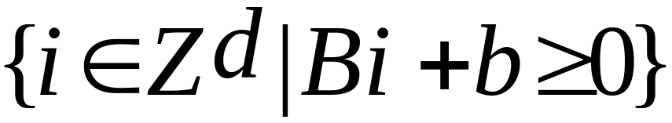
Matrix Formulation
The iterations in a d-deep loop nest can be represented mathematically as
  Z is the set of integers
  B is a d x d integer matrix
  b is an integer vector of length d, and
  0 is a vector of d 0’s.

Slide 22
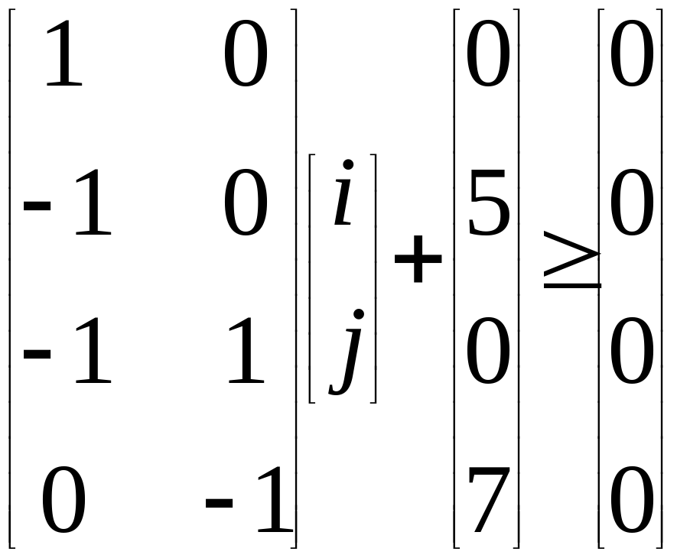
Example
for i = 0, 5
for j = i, 7
Z[j,i] = 0;
E.g. the 3rd row –i+j ≥ 0 is from the lower bound j ≥ i for loop j.

Slide 23
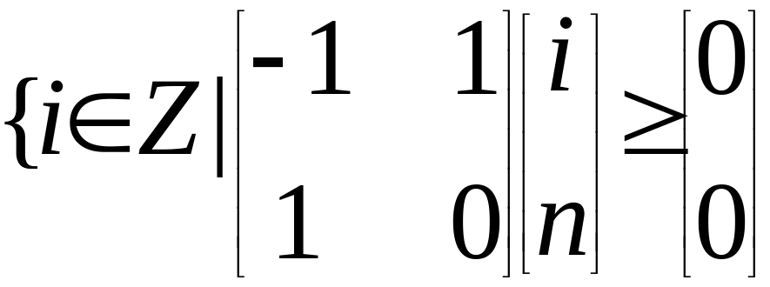
Symbolic Constants
for i = 0, n
Z[i] = 0;
E.g. the 1st row –i+n ≥ 0 is from the upper bound i ≤ n.

Slide 24
Data Space
An n-dimensional array is modeled by an n-dimensional space. The space is bounded by the array bounds.
Data space a = 0,1, …99
float Z[100]
for i = 0, 9
Z[i+10] = Z[i];
end_for

Slide 25
Processor Space
Initially assume unbounded number of virtual processors (vp1, vp2, …) organized in a multi-dimensional space.
  (iteration 1, vp1), (iteration 2, vp2),…
After parallelization, map to physical processors (p1, p2).
  (vp1, p1), (vp2, p2), (vp3, p1), (vp4, p2),…

Slide 26
Affine Array Index Function
Each array access in the code specifies a mapping from an iteration in the iteration space to an array element in the data space
Both i+10 and i are affine.
float Z[100]
for i = 0, 9
Z[i+10] = Z[i];
end_for

Slide 27
Array Affine Access
The bounds of the loop are expressed as affine expressions of the surrounding loop variables and symbolic constants, and
The index for each dimension of the array is also an affine expression of surrounding loop variables and symbolic constants

Slide 28
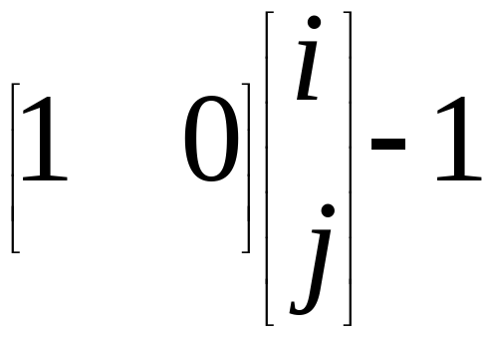
Matrix Formulation
Array access maps a vector i within the bounds to array element location Fi+f.
E.g. access X[i-1] in loop nest i,j

Slide 29
Affine Partitioning
An affine function to assign iterations in an iteration space to processors in the processor space.
E.g. iteration i to processor 10-i.
float Z[100]
for i = 0, 9
Z[i+10] = Z[i];
end_for

Slide 30
Data Access Region
An affine function to assign iterations in an iteration space to processors in the processor space.
Region for Z[i+10] is {a | 10 ≤ a ≤ 20}.
float Z[100]
for i = 0, 9
Z[i+10] = Z[i];
end_for

Slide 31
Data Dependences
Solution to linear constraints as shown in the last lecture.
  There exist i_{r}, i_{w}, such that
  0 ≤ i_{r}, i_{w} ≤ 9,
  i_{w} + 10 = i_{r}
float Z[100]
for i = 0, 9
Z[i+10] = Z[i];
end_for

Slide 32
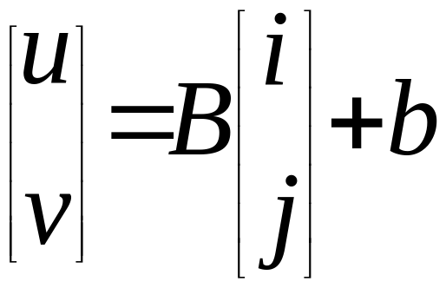
Affine Transform
j
v
i
u

Slide 33
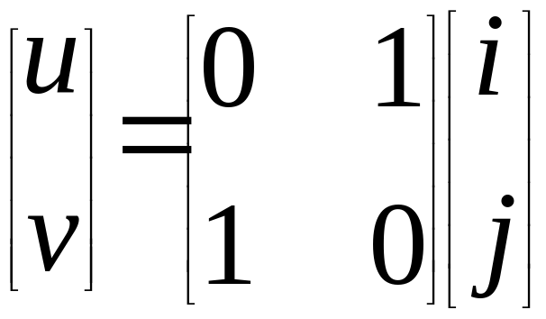
Locality Optimization
for i = 1, 100
for j = 1, 200
A[i, j] = A[i, j] + 3
end_for
end_for
for u = 1, 200
for v = 1, 100
A[v,u] = A[v,u]+ 3
end_for
end_for

Slide 34
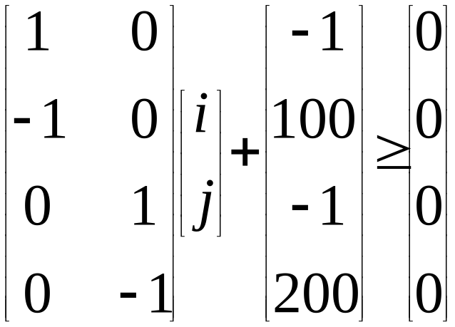
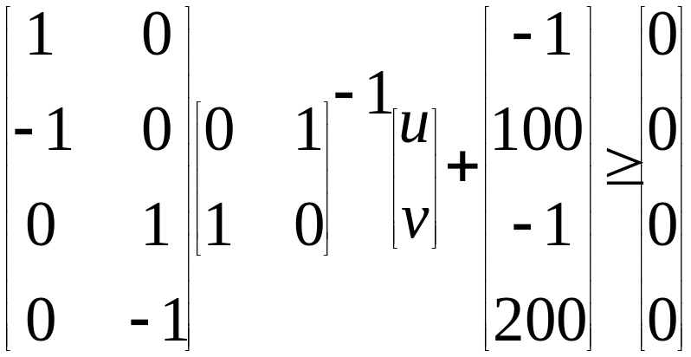
Old Iteration Space
for i = 1, 100
for j = 1, 200
A[i, j] = A[i, j] + 3
end_for
end_for

Slide 35
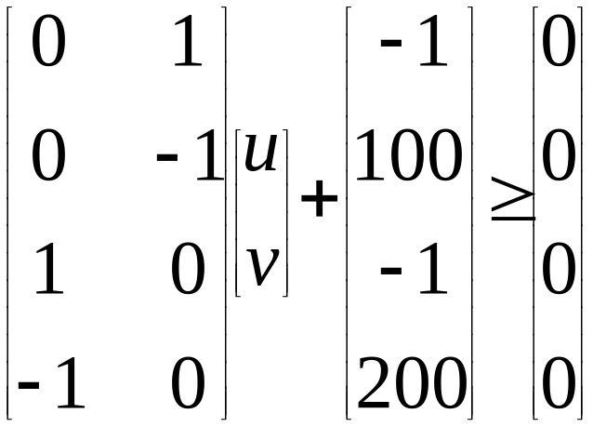
New Iteration Space
for u = 1, 200
for v = 1, 100
A[v,u] = A[v,u]+ 3
end_for
end_for

Slide 36
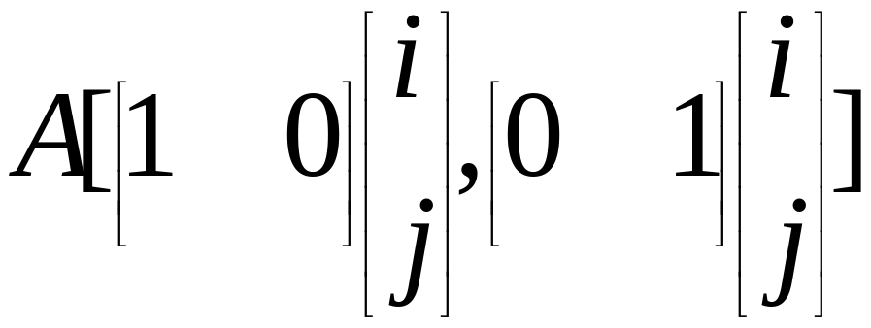
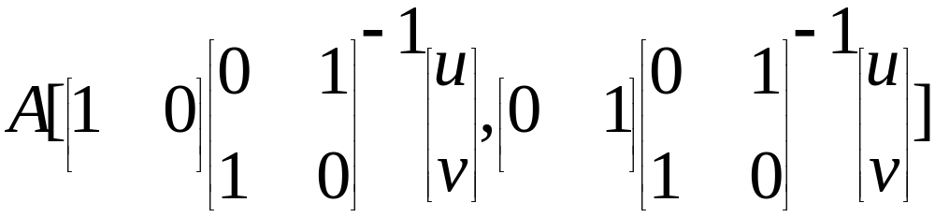
Old Array Accesses
for i = 1, 100
for j = 1, 200
A[i, j] = A[i, j] + 3
end_for
end_for

Slide 37
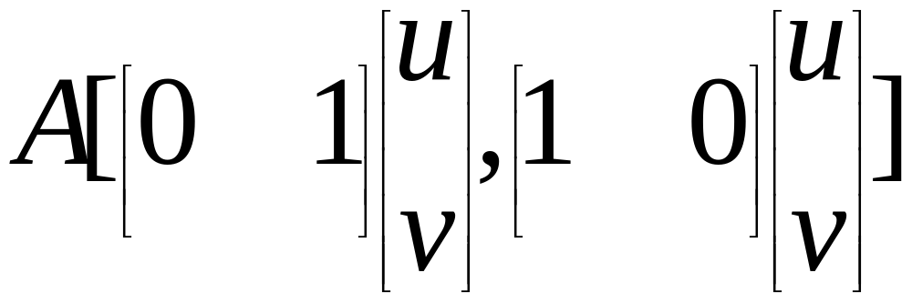
New Array Accesses
for u = 1, 200
for v = 1, 100
A[v,u] = A[v,u]+ 3
end_for
end_for

Slide 38
Interchange Loops?
for i = 2, 1000
for j = 1, 1000
A[i, j] = A[i-1, j+1]+3
end_for
end_for
j
i
e.g. dependence vector d_{old} = (1,-1)

Slide 39
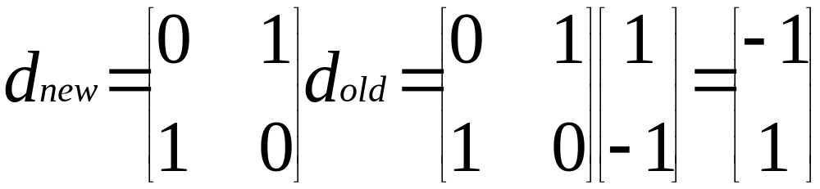
Interchange Loops?
A transformation is legal, if the new dependence is lexicographically positive, i.e. the leading non-zero in the dependence vector is positive.

Slide 40
Summary
Locality Optimizations
Loop Transformations
Affine Transform Theory

